Slide 1
EECS 498 System Design of a Search Engine
Winter 2026
Lecture 21: Negotiations
Nicole Hamilton
https://web.eecs.umich.edu/~nham/
nham@umich.edu

Slide 2
agenda
details
negotiations
the Maine house
Rose Bowl viewing party

Slide 3
agenda
details
negotiations
the Maine house
Rose Bowl viewing party

Slide 4
details
Please read my ranking paper.
The best heuristics are the ones that can cherry pick the really good matches out of the sea of trash.
Lab on getting starting on GCP will be this Friday. You’ll go from logging in the first time to building and running your LinuxGetSsl utility.

Slide 5
details
I will be working on publishing guidance on presentations, final reports, final exam, and team meetings this week.
Today will be negotiations, next will be organizational behavior, followed by time value of money.
For time value of money, you’ll need to download a free HP-12 calculator emulator.

Slide 6
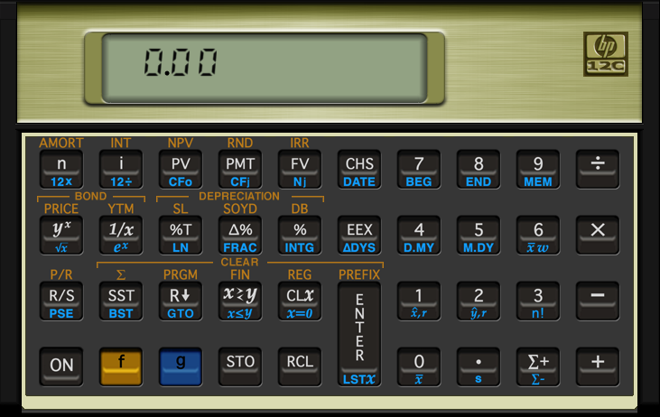
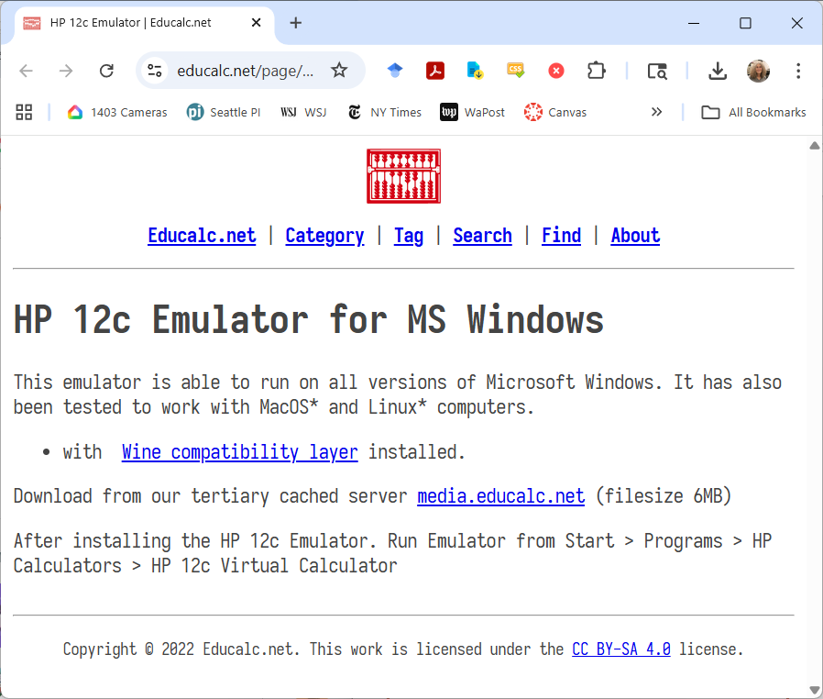
you’ll need an HP-12 emulator
Fortunately, HP released a free one. https://www.educalc.net/page/2338917/

Slide 7
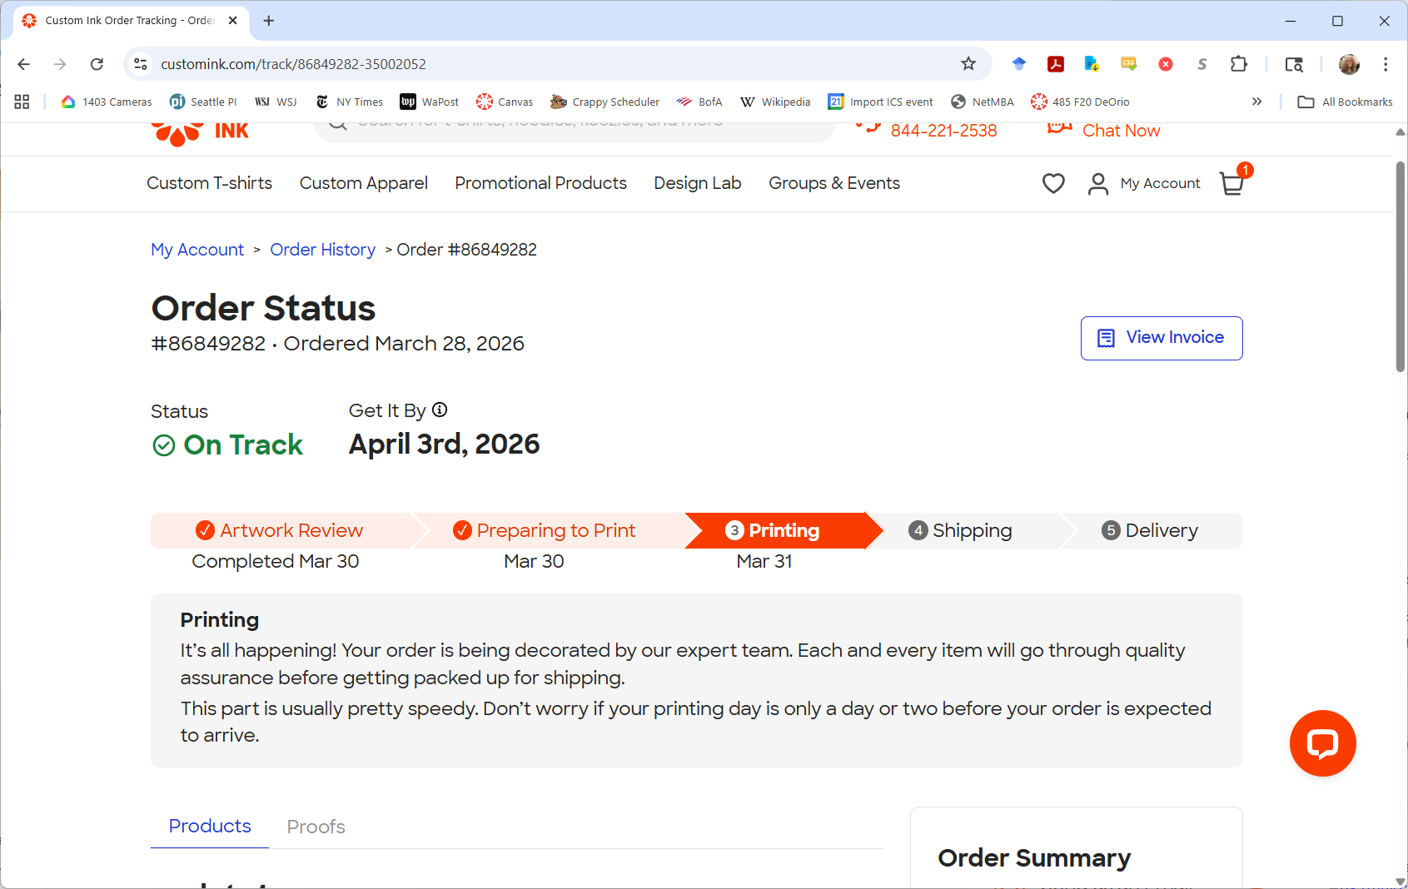
Good news on tee shirts. We should have them by Friday!

Slide 8
Our mascot is named Octavious. It never got to 50% but we exhausted the votes.
 | Round 1 | Round 2 | Round 3 | Round 4
Octavious | 8 | 8 | 8 | 10
Octothorpe | 8 | 5 | 5 | 7
Rahul | 8 | 3 | 3 | 3
tf/idf | 3 | 3 | 3 | 3
Zork | 3 | 3 | 3 | 4
George | 2 | 2 | 2
Hamilton | 2 | 2 | 4 | 4
Jeff | 2 | 2 | 2
Sami | 2 | 2 | 3
Ultros | 2 | 2 | 2
Jess | 1 | 1
Purple | 1 | 1
So Cute | 1 | 1
Carlos | 0
Gilbert | 0
Nicky | 0
Searchy | 0
Seashell | 0
Squishy | 0

Slide 9
agenda
details
negotiations
the Maine house
Rose Bowl viewing party

Slide 10
negotiations
Intended as a helpful topic for life.

Slide 11
examples
Buying a car from a dealer.
Buying or selling a car from through Craigslist.
Buying or selling a house.
Negotiating a starting salary or title.
Negotiating a quantity discount.
Negotiating a licensing agreement.
Negotiating with a potential investor.
A union negotiating with an employer.
Where to have dinner with friends.
With your spouse about whether it’s a good time to have another child.

Slide 12
bargaining is cultural
Americans expect to pay posted prices except on cars and houses or when buying outside the usual retail channel.
People growing up in other parts of the world often expect to bargain over everything.

Slide 13
Everything is negotiable.

Slide 14
Everything is negotiable
until you find out for sure it’s not.

Slide 15
Going into a negotiation, it’s helpful to know:
What you want.
The minimum you would accept.
What you think the other side wants.
What you think the other side would accept.
What happens if you don’t get an agreement.

Slide 16
Example: Buying a new car, you might research typical prices paid or dealer invoice prices.

Slide 17
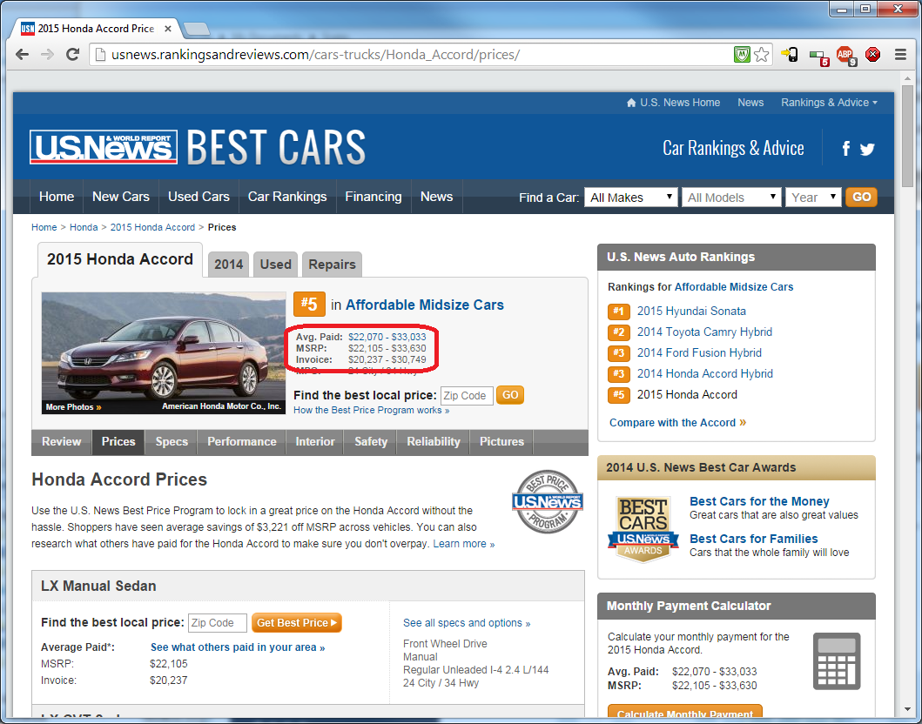

Slide 18


Slide 19
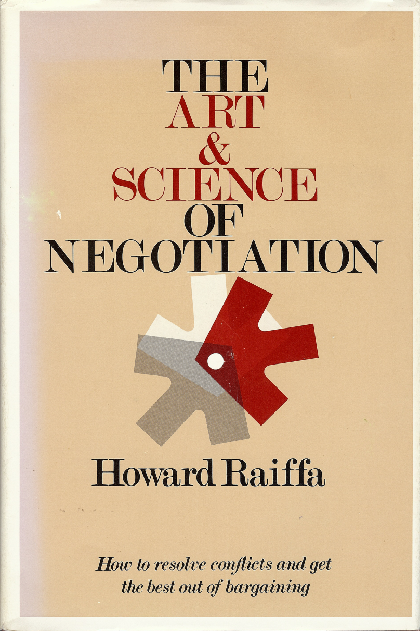

I’m going borrow from these sources.

Slide 20
Lots of negotiations are simple.
One buyer, one seller, one issue: price.
These are purely distributive.
One party’s gain is the other’s loss.
Zero sum.

Slide 21
example: selling a warehouse
Two firms negotiating the sale of a warehouse, the equipment and inventory.
The main issue is price.
Present owner is closing down.
Valuable location to the buyer, who could make use of the equipment and inventory.
Buyer estimates the value at $600K.
Seller estimates the value at $520K.
These are their reservation prices or walk-away prices.
Source: Samuelson & Marks, Managerial Economics, 7e, p. 631.

Slide 22
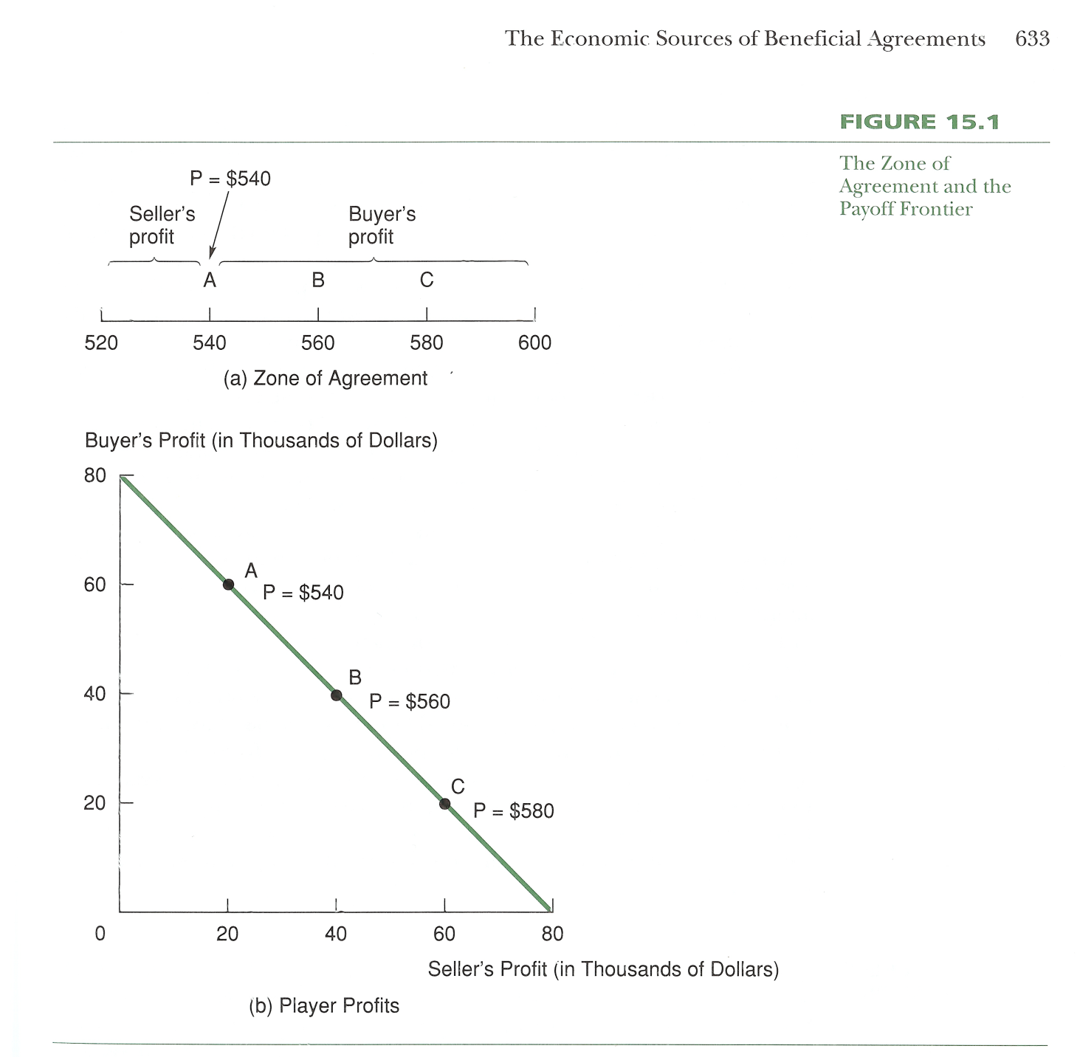
Buyer’s reserve $600K.
Seller’s reserve $520K.
Source: Samuelson & Marks, Managerial Economics, 7e, p. 633.

Slide 23
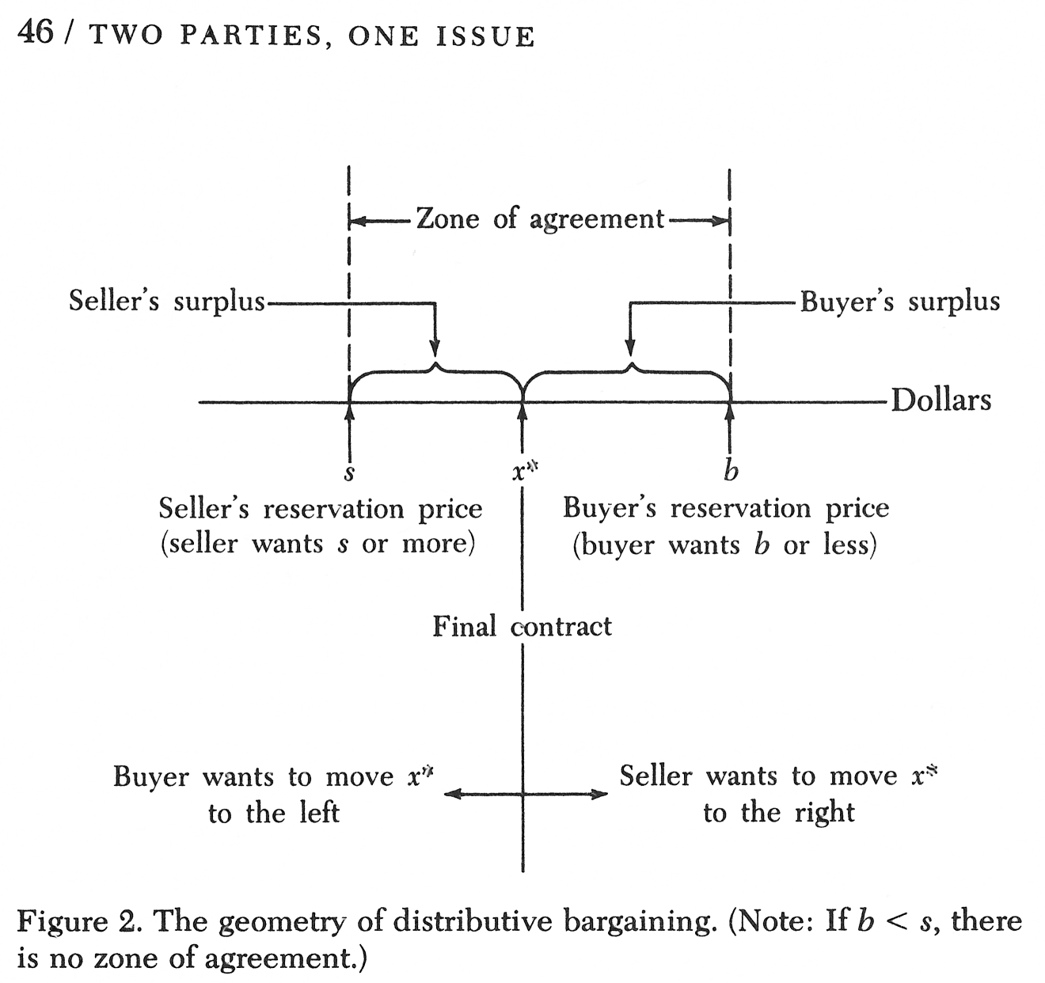
Source: Howard Raiffa, The Art & Science of Negotiation, p. 46.

Slide 24
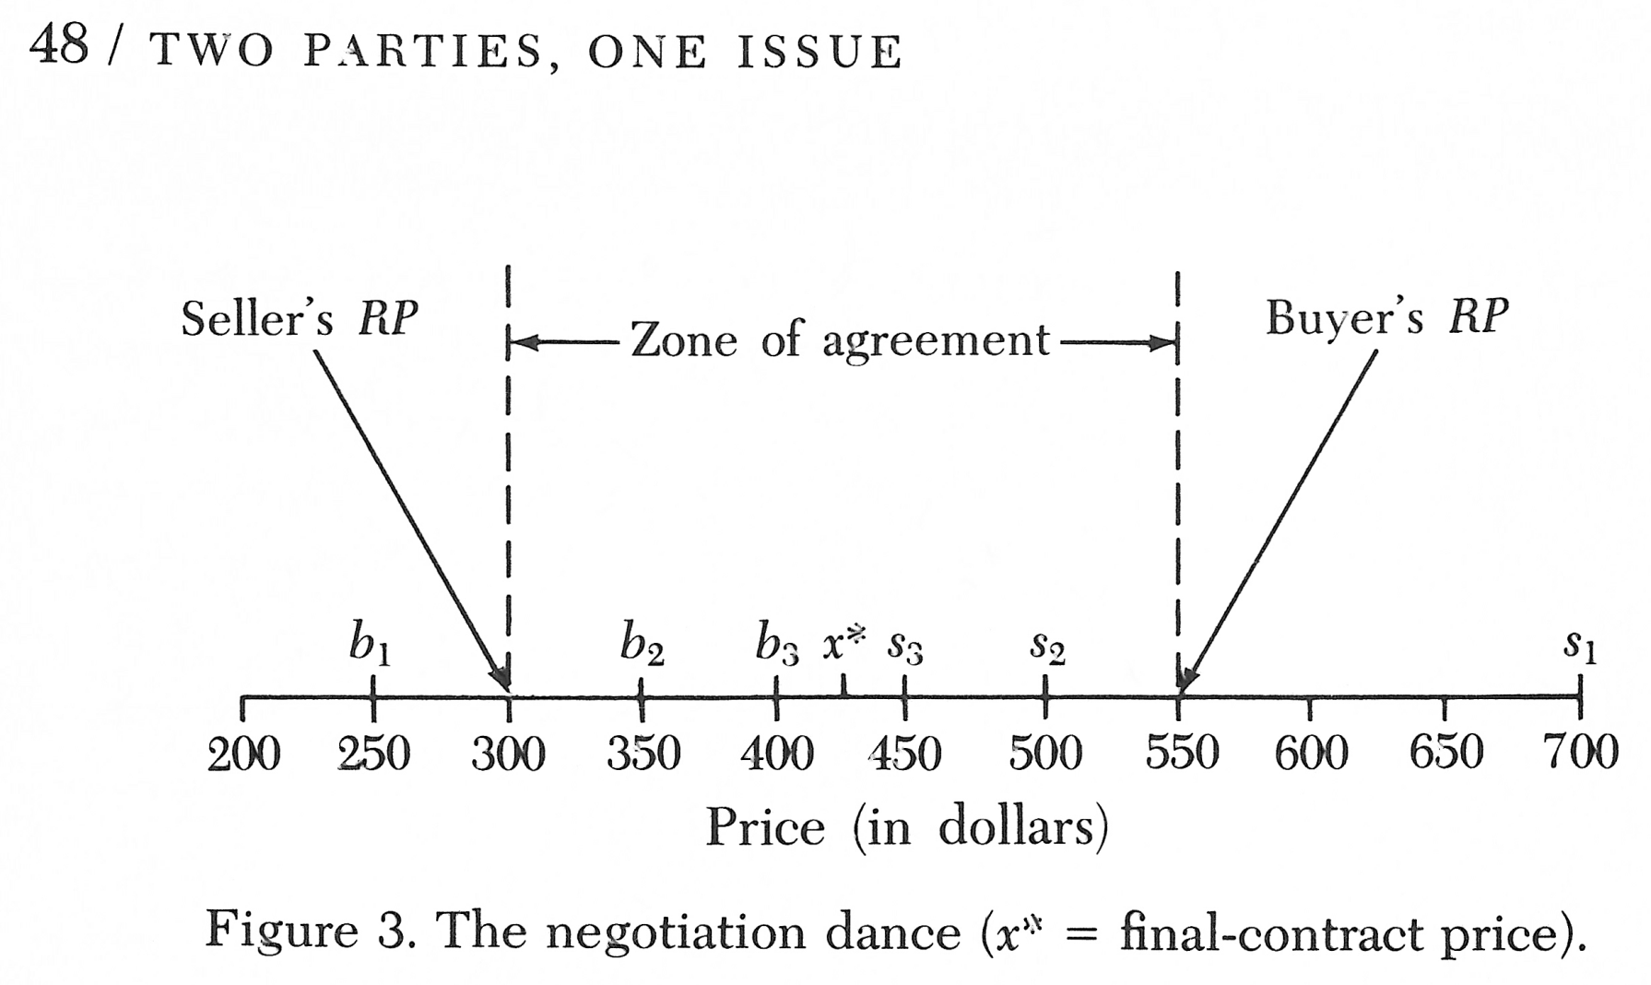
Source: Howard Raiffa, The Art & Science of Negotiation, p. 48.

Slide 25
When there are multiple issues, there is often an opportunity to enlarge the pie with concessions that are worth more to one side than the other.

Slide 26
The efficient frontier – also called the Pareto Optimal Frontier – is the locus of achievable joint evaluations from which no joint gains are possible.
Source: Raiffa, The Art & Science of Negotiation, p. 139.

Slide 27
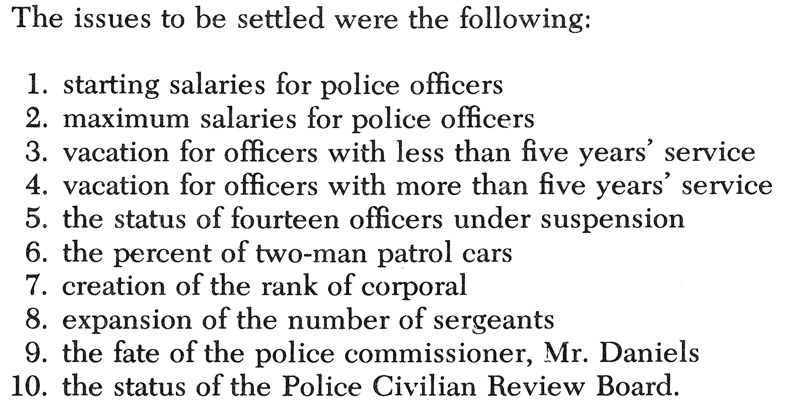
Hypothetical case
Associated Metropolitan Police Officers (AMPO) versus City.
Source: Raiffa, The Art & Science of Negotiation, p. 133 – 140.

Slide 28
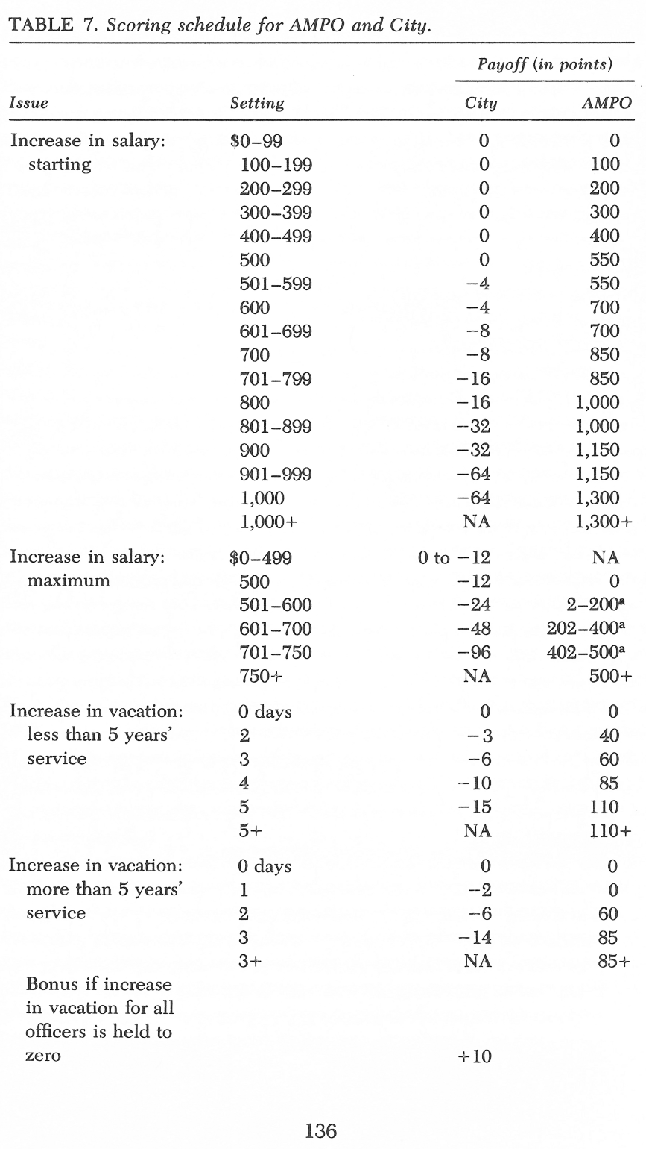
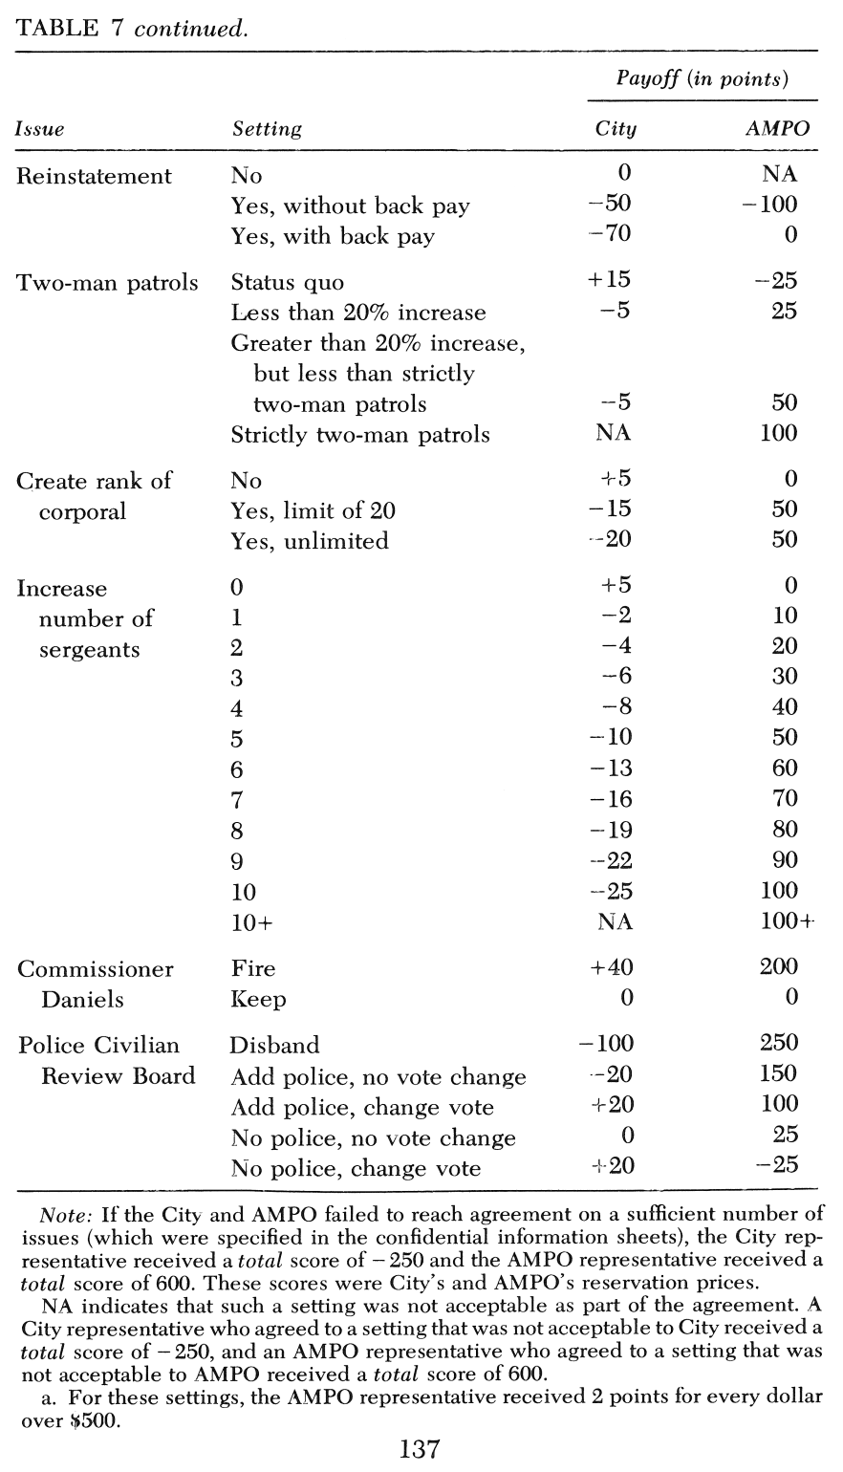

Slide 29
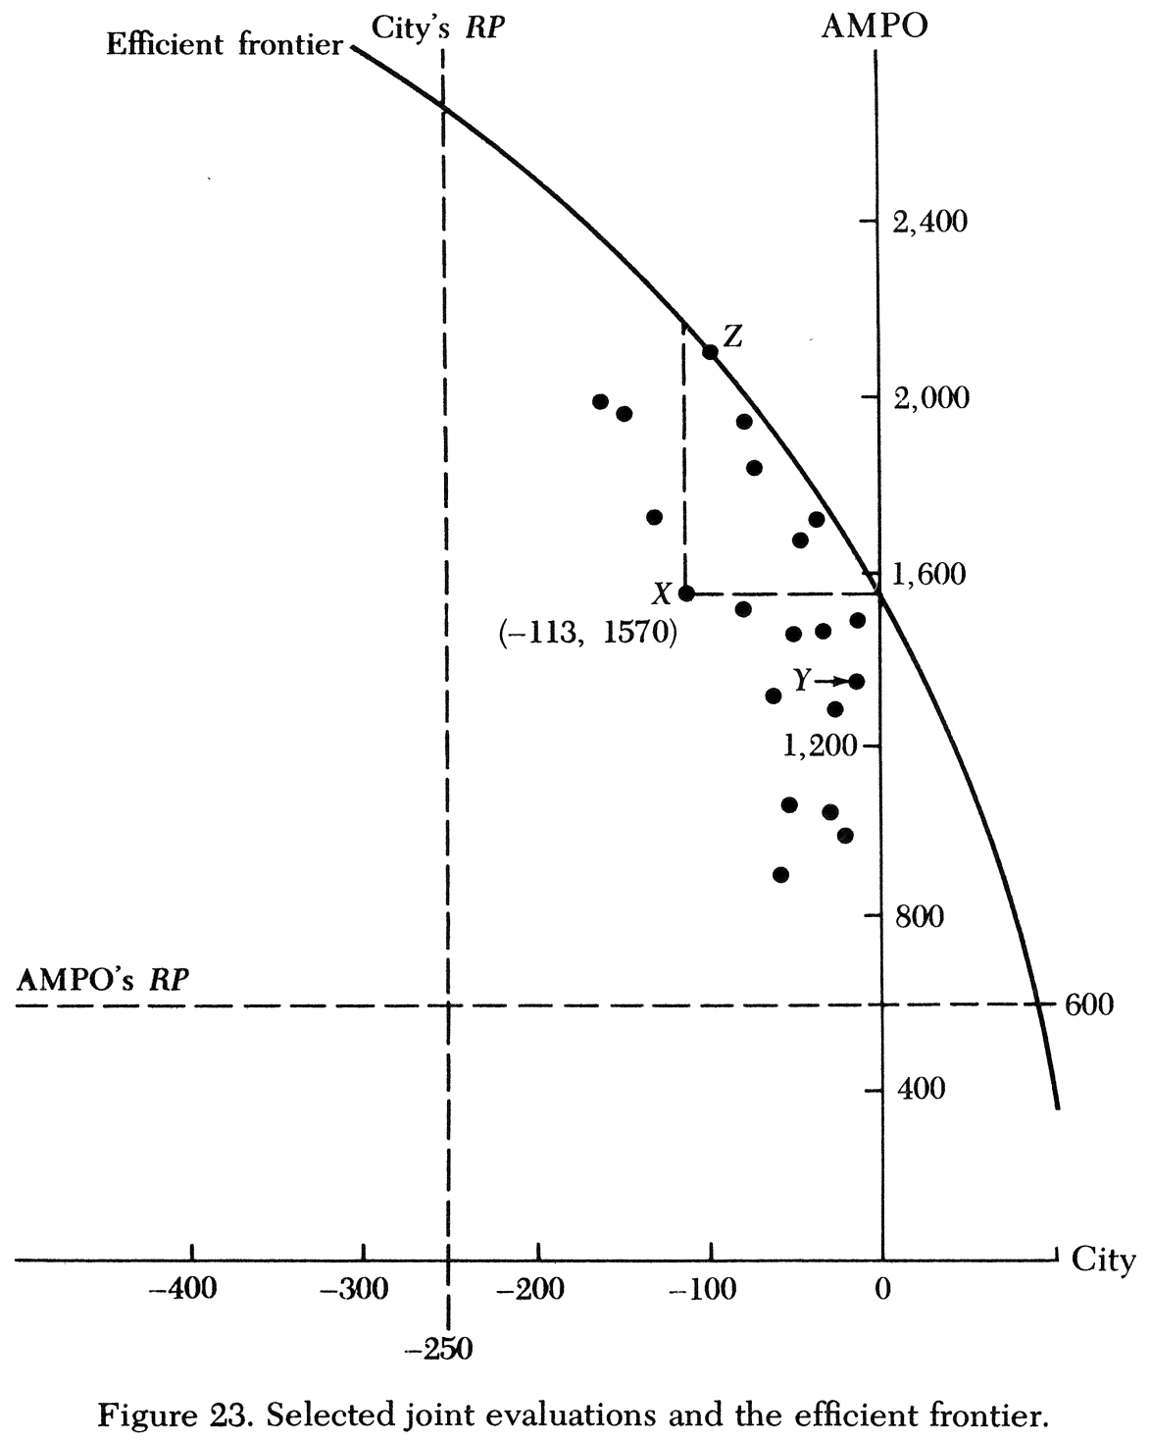

Slide 30
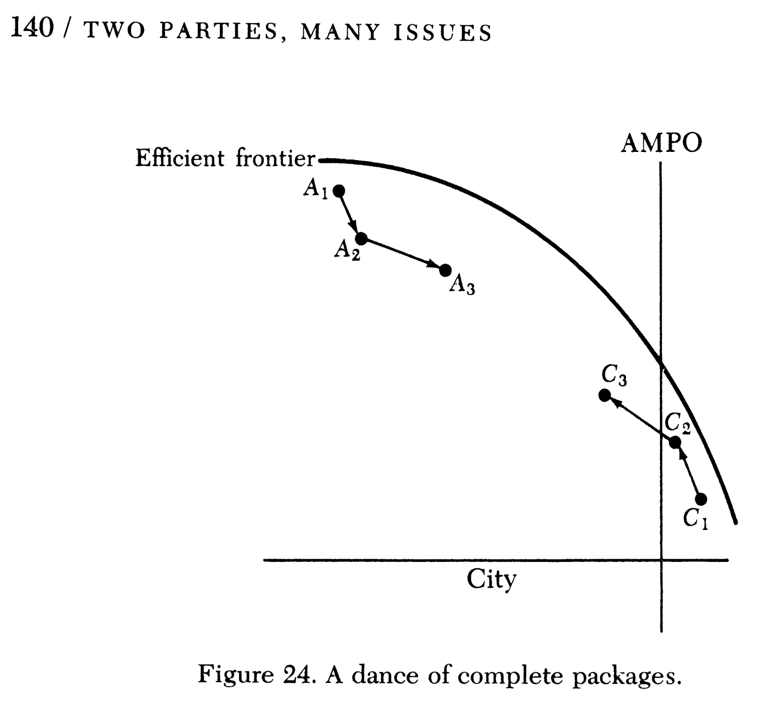

Slide 31
What makes a negotiation more complex?

Slide 32
possible complexities
Are there more than 2 parties?
Are the parties monolithic?
Is the game repetitive?
Are there linkage effects?
Is there more than one issue?
Is an agreement required?
Is ratification required?
Are threats possible?
Are there time constraints or time-related costs?
Are the contracts binding?
Are the negotiations private or public?
What are the group norms?
Is third party intervention possible?
Source: Howard Raiffa, The Art & Science of Negotiation, pp. 11-19.

Slide 33
“The most important thing in acting is honesty. Once you’ve learned to fake that, you’ve got it made.”
-- Samuel Goldwyn

Slide 34
agenda
details
negotiations
the Maine house
Rose Bowl viewing party

Slide 35
selling a Maine house
Game designed by Bill Samuelson at Boston University.
Some of you will be buyers, others sellers.
Not all of you will have the same information.
You will have 10 minutes to read and prepare for the negotiation and 15 minutes to do it and report.
We’ll count off pairs and let you decide who’s a buyer and who’s a seller.

Slide 36
Some of you will even-numbered pairs and some will be odd-numbered.
Instructions are posted in the Files > Maine House folder on Canvas.
It is up to you to decide who is the buyer and who is the seller.
Remember your pair number and keep track of:
1. Your first offers,
2. The total number of offers back-and-forth.
3. The final price and the number of acres sold.
After you finish, report your results here: https://tinyurl.com/W26MaineHouse

Slide 37
STOP HERE UNTIL AFTER YOU’VE FINISHED THE EXERCISE

Slide 38
How many think they did really well?
Did anyone get skunked (zero profit)?
Strategies that worked or did not work?
How many chose the 17 acre option?
How many chose the 14 acre option?

Slide 39
What worked well or not so well?

Slide 40
observations
Make the pie bigger. Try to create a larger zone of agreement to share.
Negotiations tend to end in the middle between the opening offers.
Biggest mistake is being too generous in the first offer. Need to ask for a lot but not so much that the expected midpoint is outside any zone of agreement. Helps to compare offers by calculating profit.
Helps to ask questions like, “Suppose we changed the deal this way? What would that do?”
It also helps to be obstinate but being unreasonable doesn’t help.
Lots of negotiations end “on the courthouse steps.”

Slide 41
two versions
All buyers had same information:
Reserve price of $150K for house + 17 acres
or $127K for house + 14 acres
Odd sellers:
Reserve price of $120K for house + 17 acres
or $107K for house + 14 acres
Even sellers:
Reserve price of $120K for house + 17 acres
or $85K for house + 14 acres

Slide 42
odd pairs
House + 17 acres:
  Buyer’s reserve $150K
  Seller’s reserve $120K
  “Profit” to be split $ 30K
House + 14 acres:
  Buyer’s reserve $127K
  Seller’s reserve $107K
  “Profit” to be split $ 20K
Most odd pairs should pick the house + 17 acres option because there’s more profit to split.

Slide 43
even pairs
House + 17 acres:
  Buyer’s reserve $150K
  Seller’s reserve $120K
  “Profit” to be split $ 30K
House + 14 acres:
  Buyer’s reserve $127K
  Seller’s reserve $ 85K
  “Profit” to be split $ 42K
Most even pairs should pick the house + 14 acres option.

Slide 44
agenda
details
negotiations
the Maine house
Rose Bowl viewing party

Slide 45
another negotiation
You are to negotiate a menu and price at a sports bar for an alumni Rose Bowl viewing party.
The menu is mostly settled except for the choice of deviled eggs or shrimp as an appetizer.

Slide 46
Major Event Grill’s published buffet menu.
Build your own buffet! All prices are per person.
Antipasto Plate (V) (G) $4
Assorted Gourmet Pizzas (V) $4
Bacon Wrapped Shrimp with a Smokey Remoulade (G) $5
Teriyaki Chicken & Pineapple Kabobs (G) $4
Cocktail Crab Cakes with Lemon Aioli $6
Coconut Crusted Shrimp with Louie Sauce $5
Crab & Artichoke Dip with Crackers $5
Creamy Spinach and Artichoke Dip with Tortilla Chips $3
Crispy Chicken Tenders with Trio of Dipping Sauces $4
Sliders with Tomato & Cheese (Angus Beef, Chicken, BBQ Pork, Veggie) (V) $4
Fresh Tomato & Garlic Bruschetta (V) $3
Pork Pot Stickers with Soy Dipping Sauce $3
Portabella Mushroom Skewers Stuffed with Roasted Garlic (V) (G) $3
Skewered Meatballs with Sweet & Spicy BBQ or Garlic-Tomato Sauce $3
Spanakopita - Filo Triangles Stuffed with Spinach and Feta $4
Stuffed Mushroom Caps $3
(choice of bacon (G), cream cheese & onion (G) or spinach & parmesan)
Teriyaki Beef Skewers with Toasted Sesame Seeds (G) $4
Thai Chicken Skewers with Peanut Dipping Sauce (G) $4
Vegetable Spring Rolls with Sweet Chili Sauce (V) $3.50
Zesty Queso Dip with Fresh Tortilla Chips (V) $3
Quesadilla (Chicken, or Cheese) (V) $3/$2.50
(V)=Vegetarian Friendly
(G) = Gluten Free Option
Dessert
Homestyle Cookies $4
Miniature Cheesecakes $4
Apple Crisp $4
Assorted Desserts $10

Slide 47
the planned menu
As Guests Arrive
Stuffed Mushroom Caps with Spinach & Parmesan
Fresh-made Tortilla Chips
Teriyaki Beef Skewers with Toasted Sesame Seeds
One additional appetizer: either Chilled Shrimp with Cocktail Sauce or Deviled Eggs
At Start of Game
Assorted Gourmet Pizzas
French Fries
Angus Beef Sliders with Tomato & Cheese
BBQ Pork Sliders
Roasted Chicken Legs, Thighs and Breasts with Garlic & Rosemary
Tossed Field Greens with Assorted Dressings & Toppings
At Halftime
Apple Crisp
Mini Cheesecakes

Slide 48
another negotiation
Same rules as before, sellers can only go down, buyers can only go up, but you can repeat the same offer and you can change the appetizer any time you like.
Details on Canvas in the Files > Rose Bowl party folder.
Some of you are A teams, some are B.
Record your results here: https://tinyurl.com/W26RoseBowl

Slide 49
non-serious offers
Would a real buyer offer $1?
Would a real seller try to charge $48?
What would actually happen?

Slide 50
how many buffets is this?
As Guests Arrive
Stuffed Mushroom Caps with Spinach & Parmesan
Fresh-made Tortilla Chips
Teriyaki Beef Skewers with Toasted Sesame Seeds
One additional appetizer: either Chilled Shrimp with Cocktail Sauce or Deviled Eggs
At Start of Game
Assorted Gourmet Pizzas
French Fries
Angus Beef Sliders with Tomato & Cheese
BBQ Pork Sliders
Roasted Chicken Legs, Thighs and Breasts with Garlic & Rosemary
Tossed Field Greens with Assorted Dressings & Toppings
At Halftime
Apple Crisp
Mini Cheesecakes

Slide 51
eggs or shrimp

Slide 52
the deviled eggs
Who wants them?
Is it important to the buyer?
What difference does that make to the seller?
How hard can this be?

Slide 53
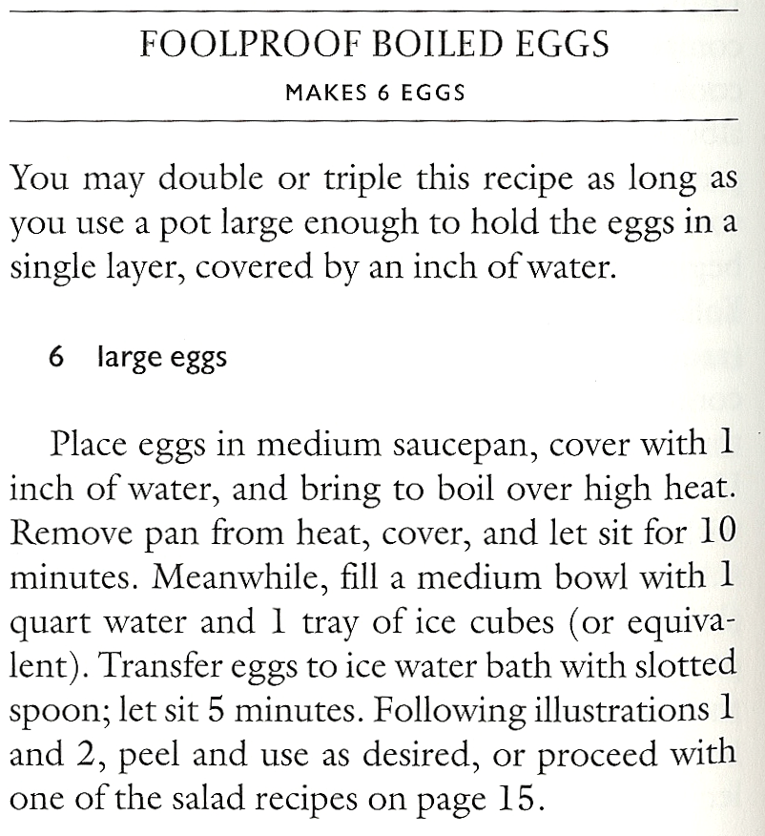
Source: Cook’s Illustrated, March/April 1999, p. 14

Slide 54
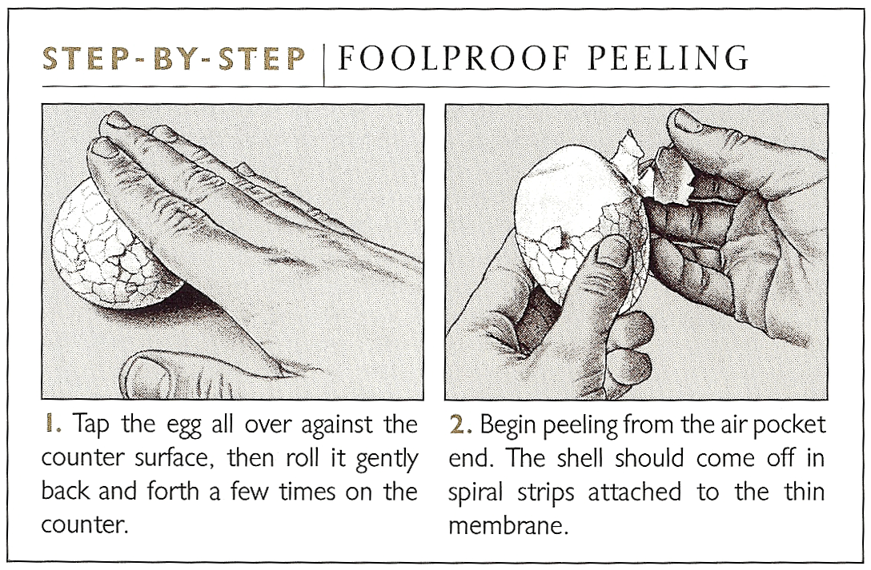
Source: Cook’s Illustrated, March/April 1999, p. 14

Slide 55

I’ve been looking for an easer way.
I have not found it.

Slide 56
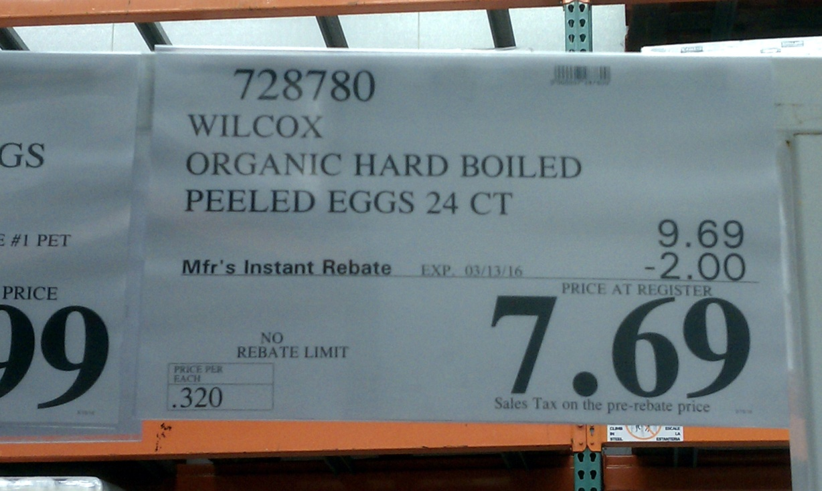
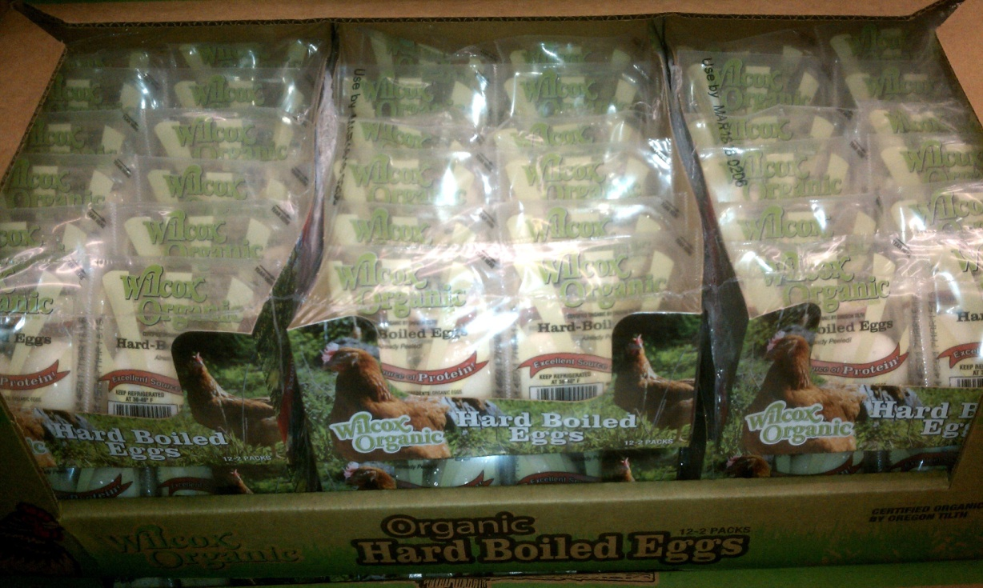
Recently discovered at Costco.
But you still have to make the deviled eggs.

Slide 57
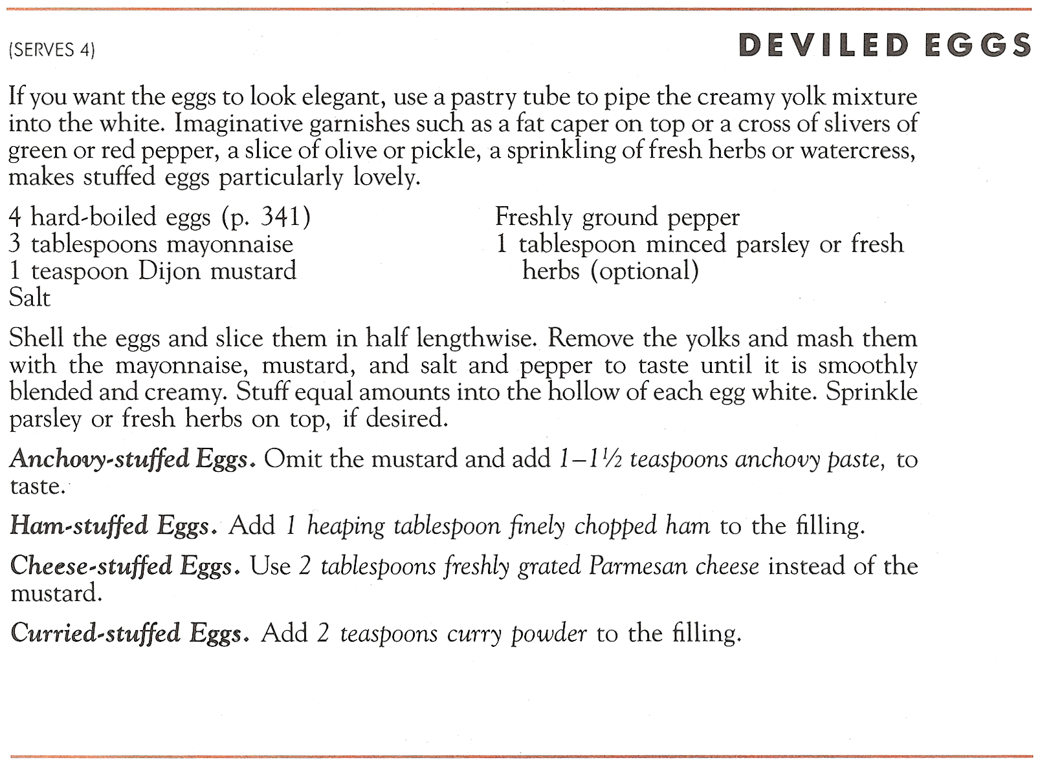
Source: Marion Cunningham, The Fannie Farmer Cookbook, p. 57

Slide 58
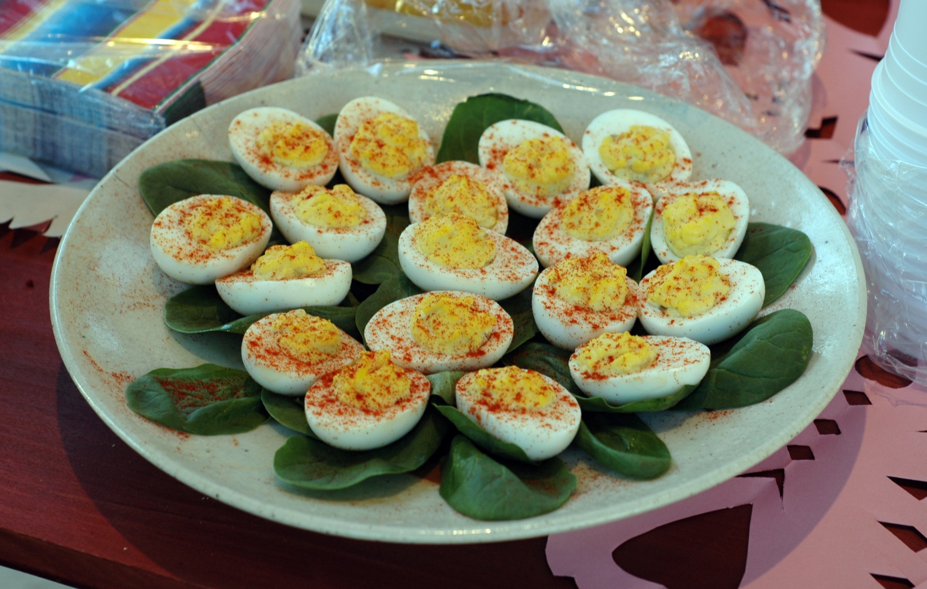
You also have to make them look nice.
Source: https://en.wikipedia.org/wiki/Deviled_egg

Slide 59
Cold boiled shrimp recipe
Thaw.
Serve.

Slide 60
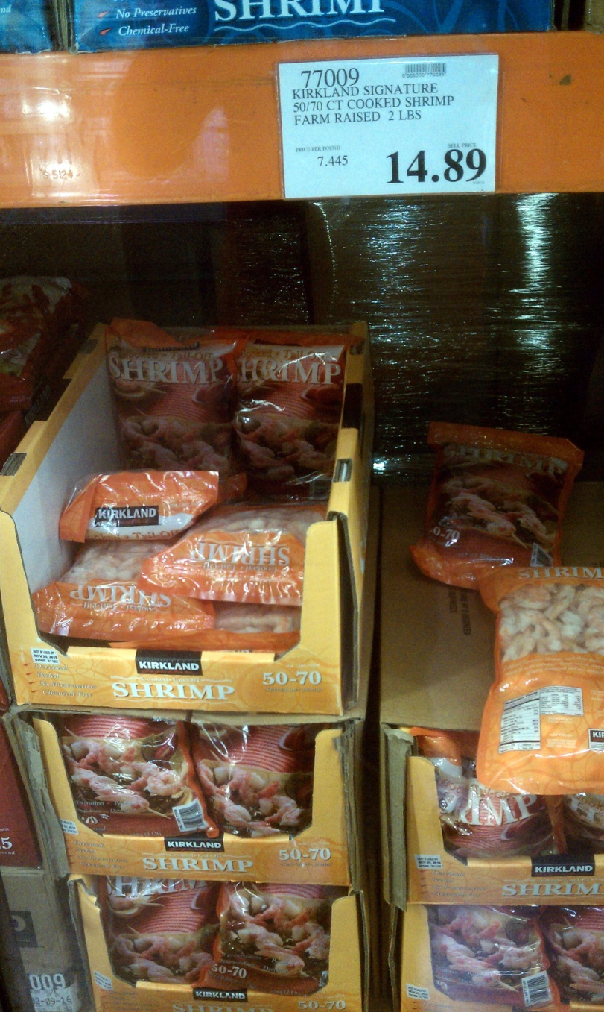
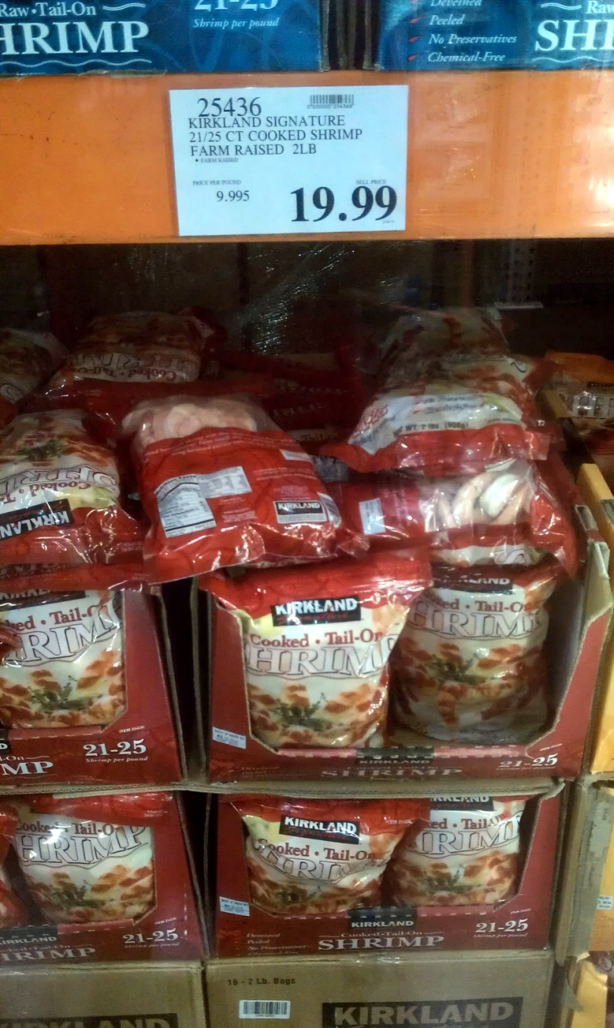

Slide 61
Raw materials cost comparison
Deviled eggs
Assuming 3 eggs: ~ $1
Shrimp
Assuming 5 large shrimp: ~ $4

Slide 62
but …
You have to know where to get the already-peeled eggs.
You still have to make them and they need to look nice.
You have to clean up anything that’s dropped.
Shrimp looks higher value and takes almost no work at all.

Slide 63
in real life
Minus the completely imaginary drama, I actually did this negotiation in 2012 with the World Sports Grill in Seattle on behalf of the Stanford Alumni Club of Seattle.
The actual price I got was $18.

Slide 64
in real life
When I did this negotiation, I actually did ask about deviled eggs.
The manager instantly pointed out and explained why it would be really difficult in her kitchen with her staff.

